Slide 1
Chapter 7. 커뮤니티 분석 실습1
2018. 07.

Slide 2
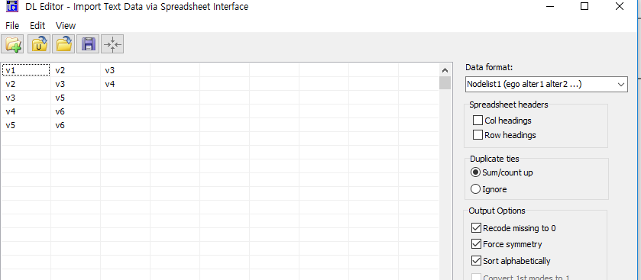
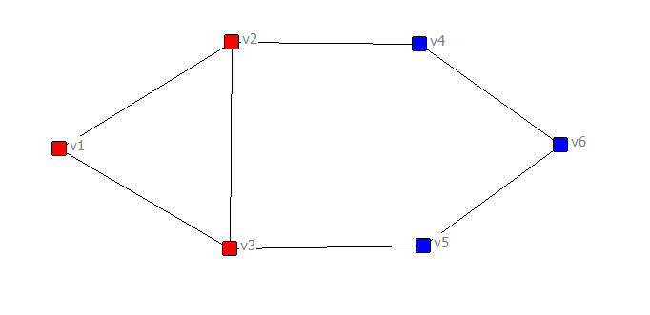
In UCINET
예제 노드 리스트

Slide 3
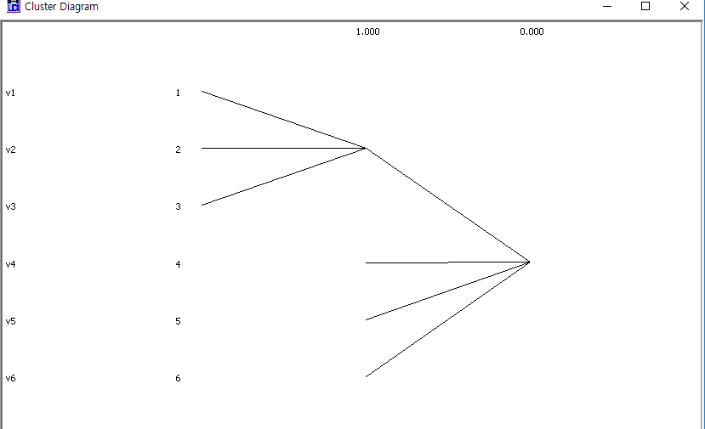
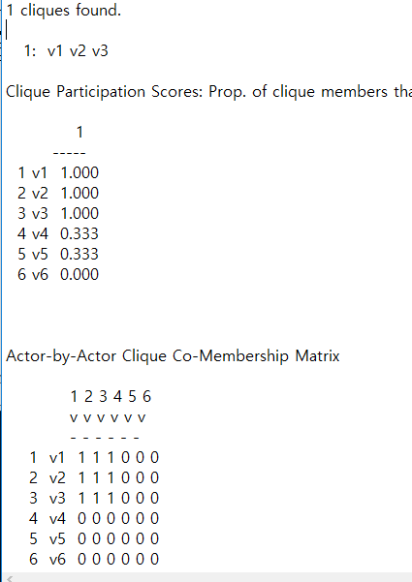
Network-subgroups-clique

Slide 4
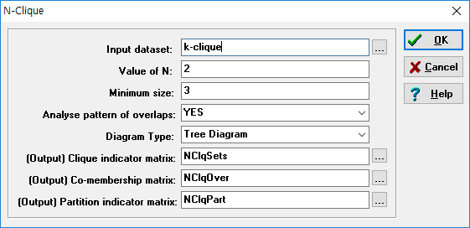
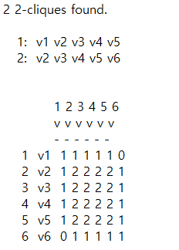
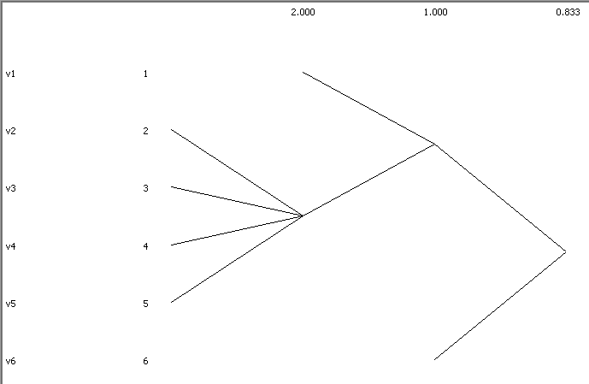
Network-subgroups-k-clique

Slide 5
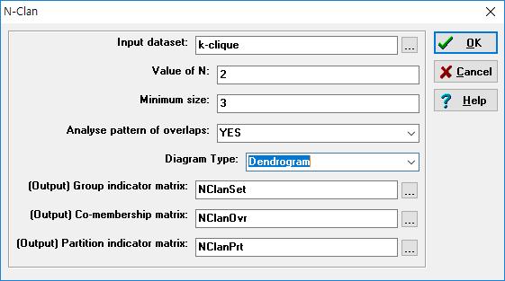
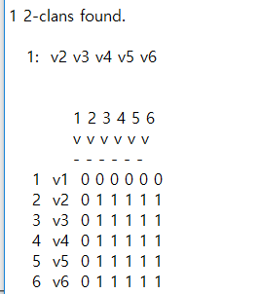
Network-subgroups-k-clan

Slide 6
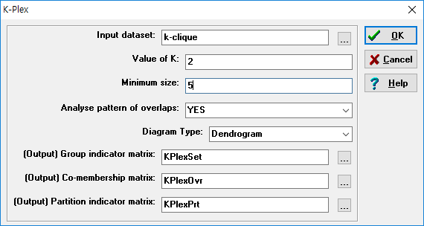
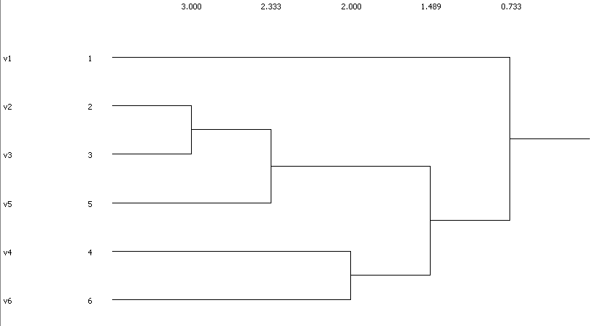
Network-subgroups-k-plex

Slide 7
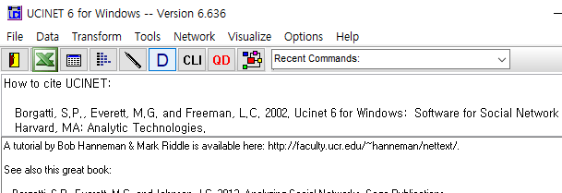
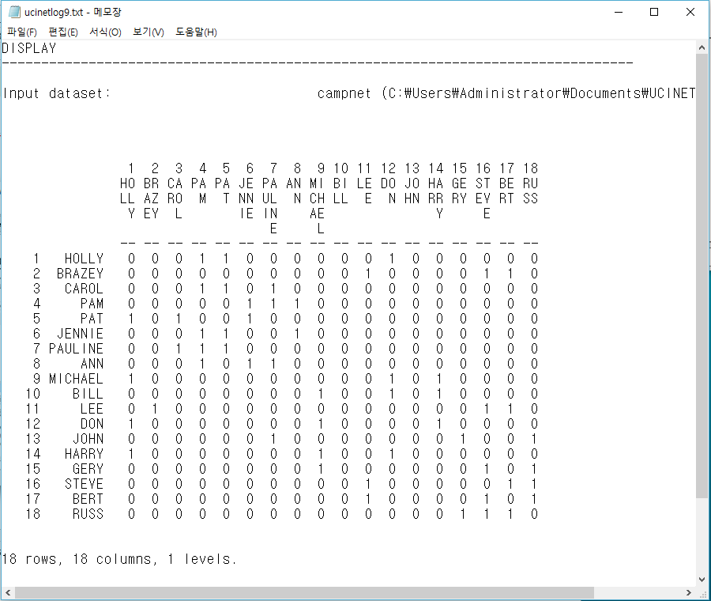
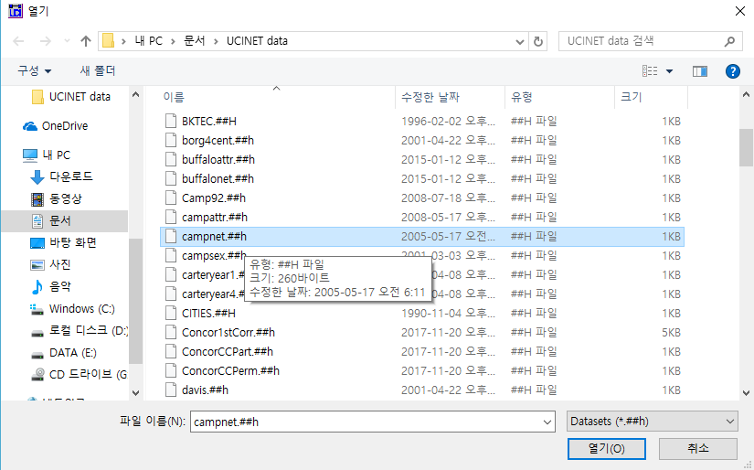
In UCINET
campnet 데이터셋을 활용하여 네트워크 분석
18명이 3주의 워크숍 후 자신과 가장 교류가 많았던 3명을 지목

Slide 8
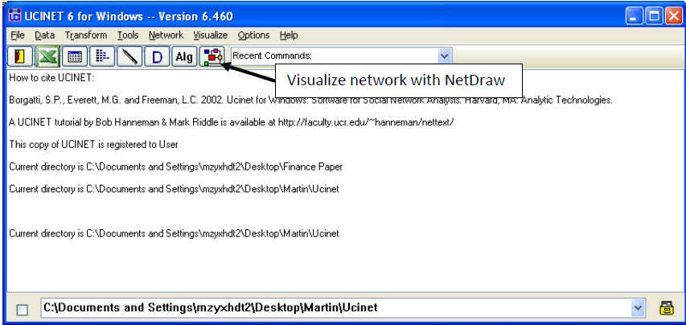
NetDraw로 그래프 보기

Slide 9
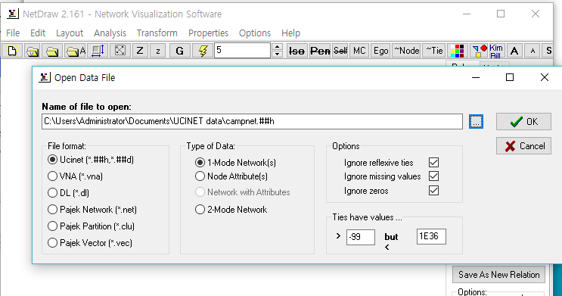
NetDraw로 그래프 보기

Slide 10
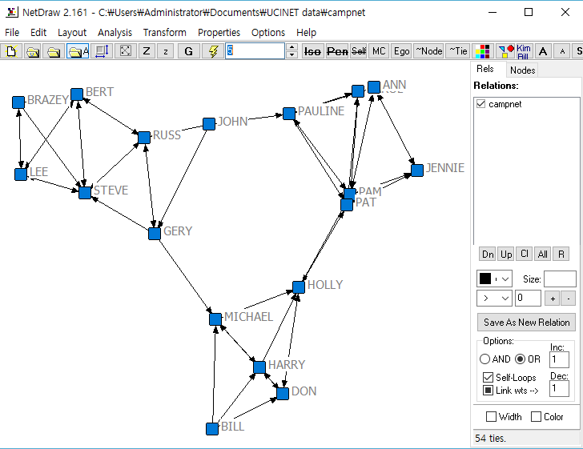
NetDraw로 그래프 보기

Slide 11
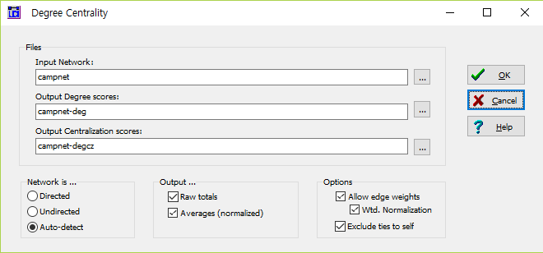
중심도 측정하기
연결중심도 측정 : Network->Centrality and Power->Degree

Slide 12
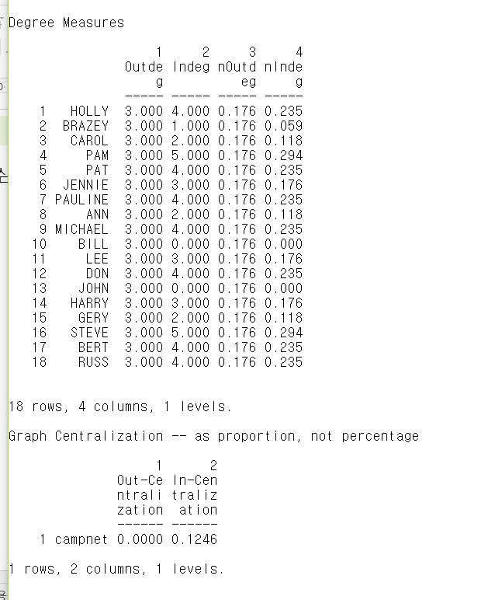
중심도 측정하기

Slide 13
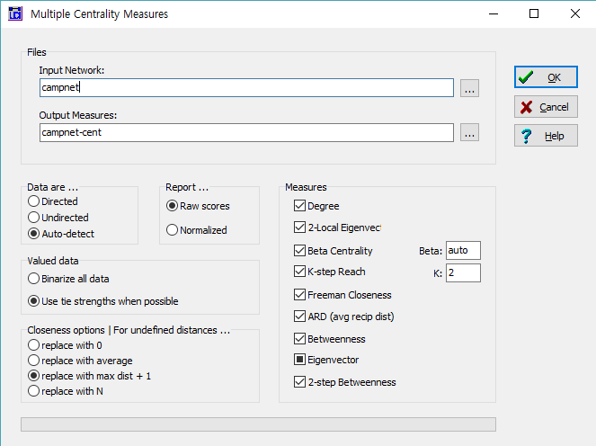
중심도 측정하기
중심도 측정 : Network->Centrality and Power->Multiple Measures

Slide 14
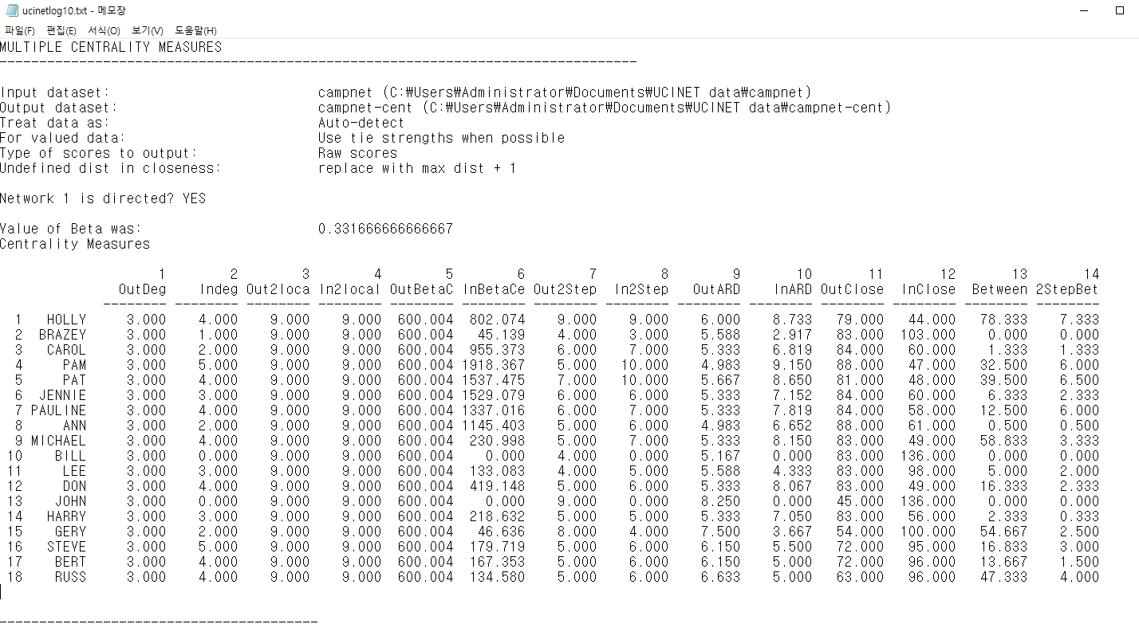
중심도 측정하기

Slide 15
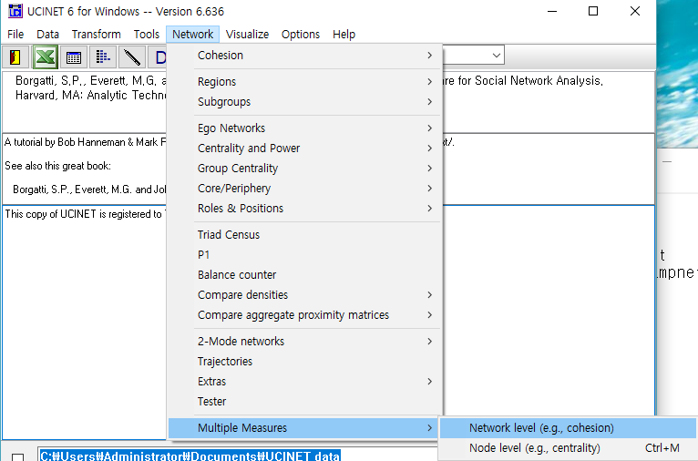
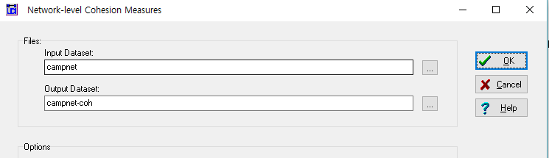
네트워크 측정
cohesion 측정 : Network->Multiple Measures >Network level

Slide 16
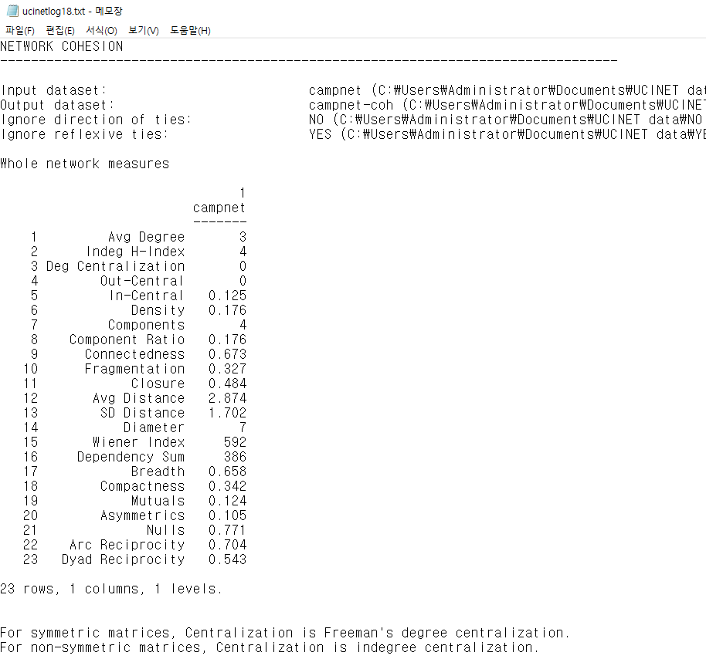
네트워크 측정

Slide 17
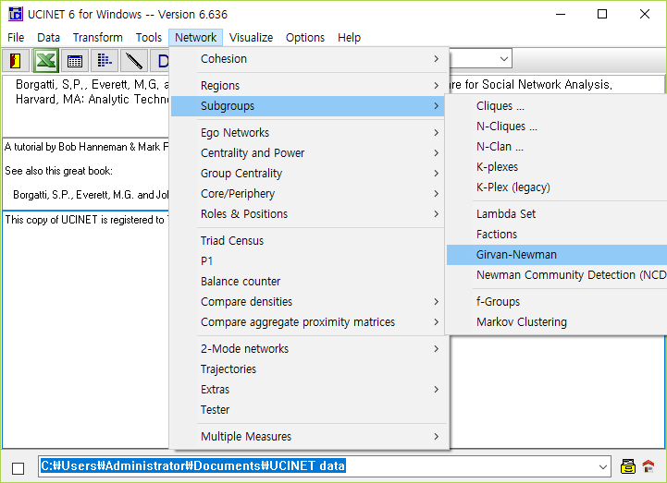
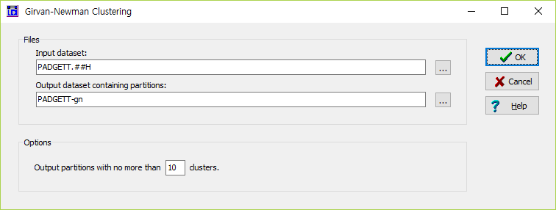
커뮤니티 분석
Girvan-Newman Algorithm

Slide 18
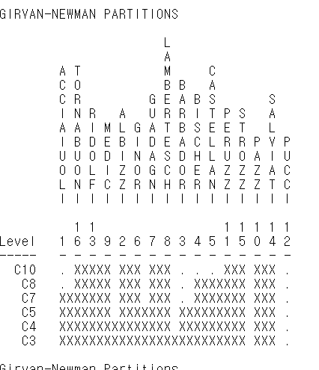
커뮤니티 분석
6개의 서브그룹

Slide 19
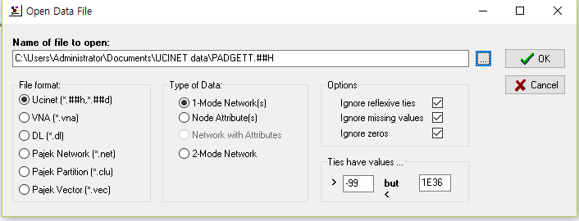
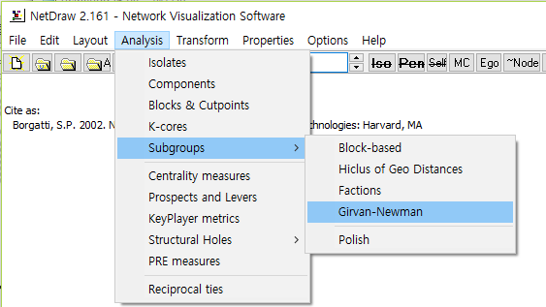
커뮤니티 분석

Slide 20
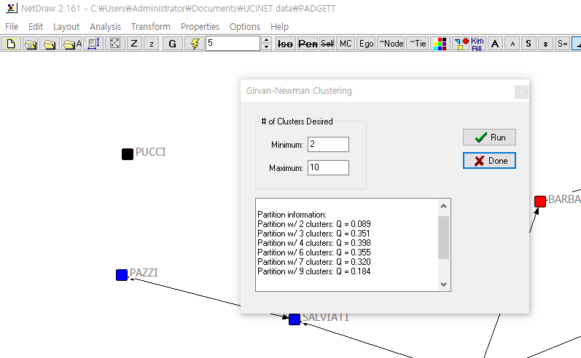
커뮤니티 분석

Slide 21
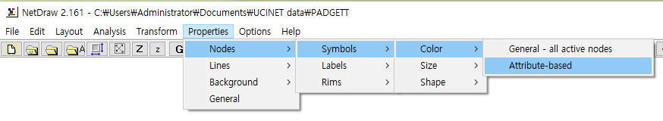
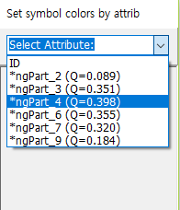
커뮤니티 분석

Slide 22
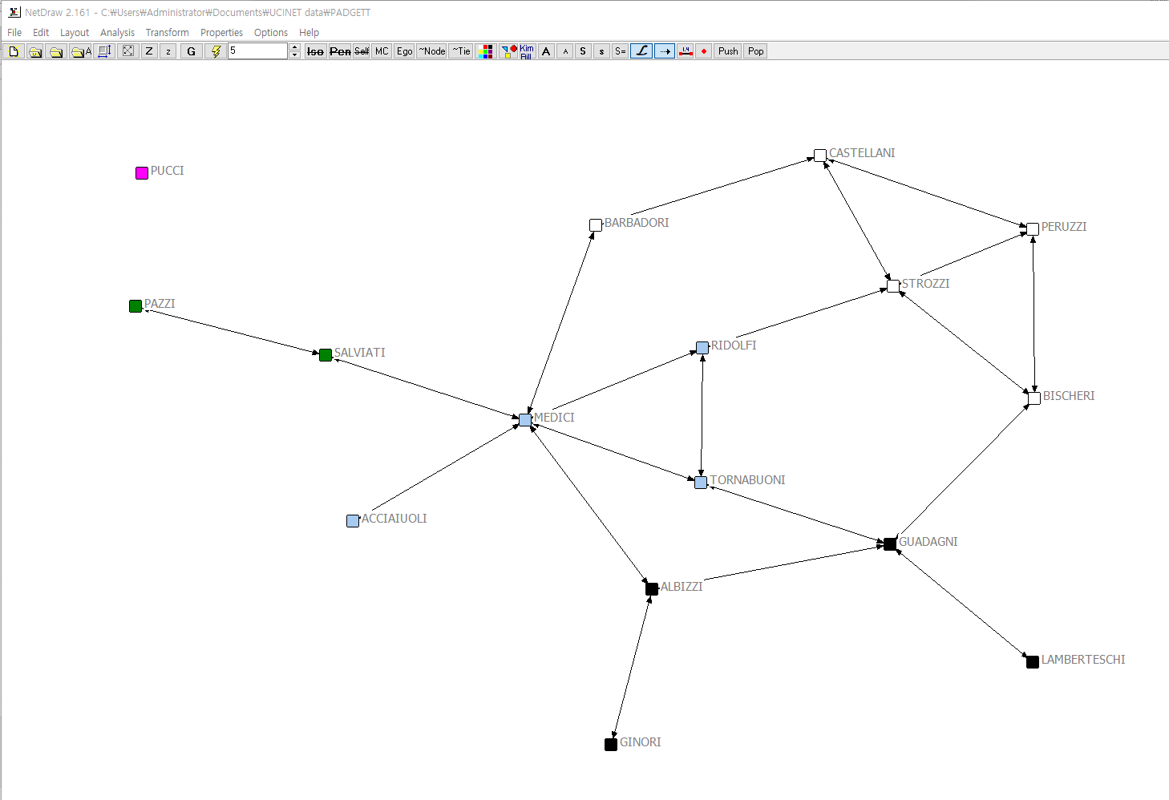
커뮤니티 분석

Slide 23
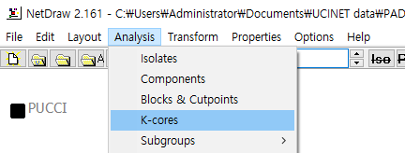
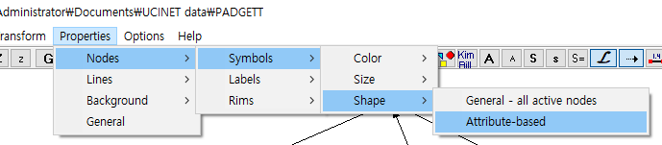
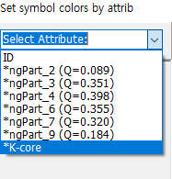
k-코어

Slide 24
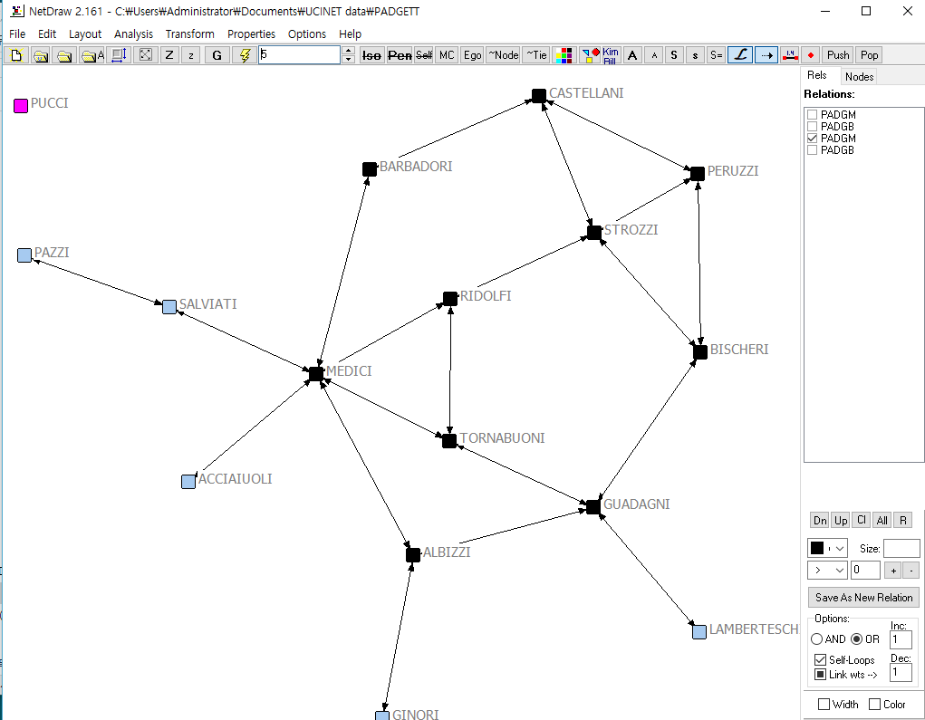
k-코어

Slide 25
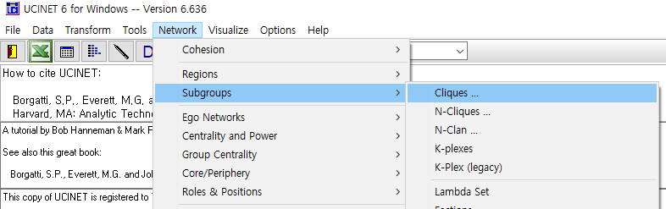
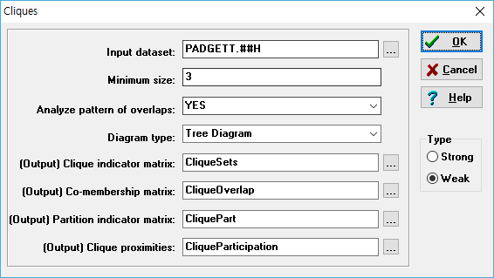
클릭

Slide 26
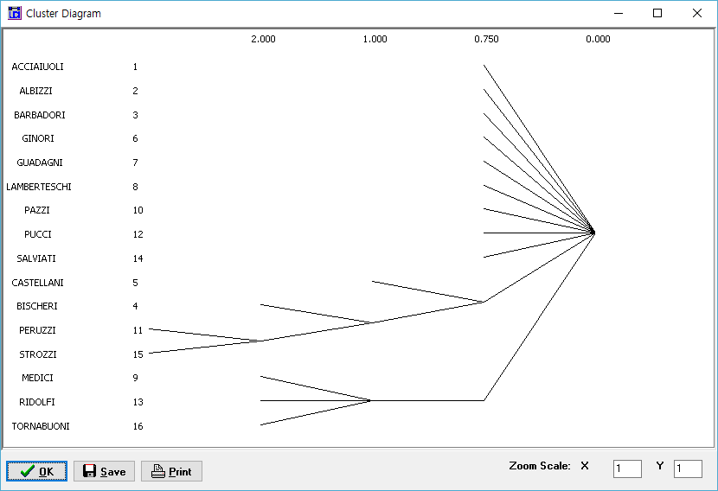
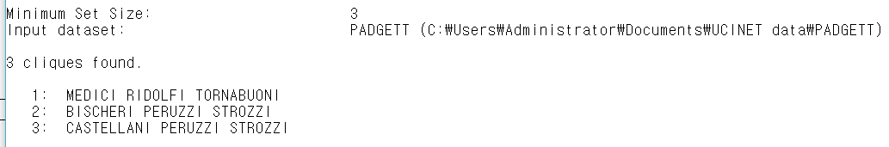

Slide 27
In R
edge.betweenness.community [Newman and Girvan, 2004]
fastgreedy.community [Clauset et al., 2004]: modularity greedy optimization method.
label.propagation.community [Raghavan et al., 2007]: This is a fast, nearly linear time algorithm for detecting community structure in networks. It works by labeling the vertices with unique labels and then updating the labels by majority voting in the neighborhood of the vertex.
leading.eigenvector.community [Newman, 2006]
multilevel.community [Blondel et al., 2008]: This is a multi-level modularity optimization algorithm (the Louvain method).
optimal.community [Brandes et al., 2008]: Works by maximizing the modularity measure over all possible partitions.
spinglass.community [Reichardt and Bornholdt, 2006]: tries to find communities in graphs via a spin-glass model and simulated annealing.
walktrap.community [Pons and Latapy, 2005]: tries to find densely connected subgraphs (communities) in a graph via random walks. The idea is that short random walks tend to stay in the same community
infomap.community [Rosvall and Bergstrom, 2008]: Find community structure that minimizes the expected description length of a random walker trajectory.

Slide 28
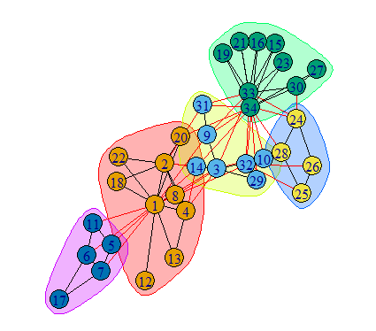
karate <- graph.famous("Zachary")
wc <- walktrap.community(karate)
modularity(wc)
membership(wc)
plot(wc, karate) # plot(karate, vertex.color=membership(wc))

Slide 29
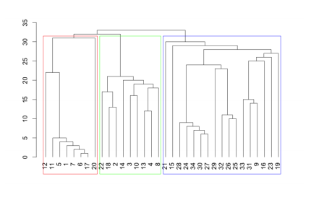
karate <- graph.famous("Zachary")
fc <- fastgreedy.community(karate)
dendPlot(fc)

Slide 30
R 실습과제
주어진 Wikipedia.glm 데이터를 로딩하시오.
wiki <- read.graph("wikipedia.gml", format="gml")
임의의 커뮤니티 검출 알고리즘을 사용하여 군집화 하시오.
군집의 의미가 있는지 간단히 기술하시오.
Label 속성을 보고 판단

